Slide 1

Introduction to Power BI platform

Slide 2
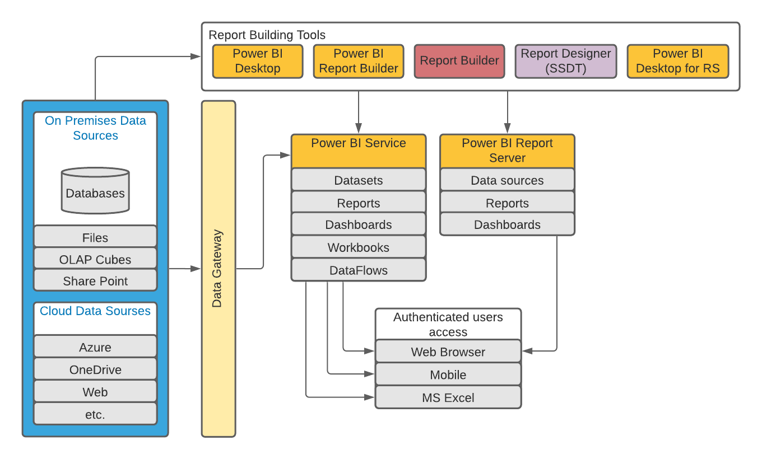
Introduction to Power BI platform
Architecture
Main components:
Power BI Service
Power BI Desktop
Data Sources
Power BI Gateway
Power BI Report Server
Power BI Report Builder & Report Builder & Report Designer (SSDT)
Power BI Mobile
Power BI Embedded

Slide 3
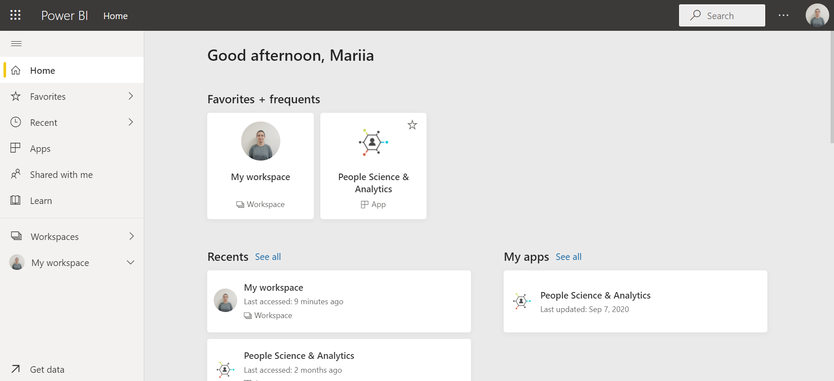
Introduction to Power BI platform
Power bi service
Power BI Service is a web-based platform from where you can share reports made on Power BI Desktop, collaborate with other users, and create dashboards and reports.
Power BI Service home link:
https://app.powerbi.com/home

Slide 4
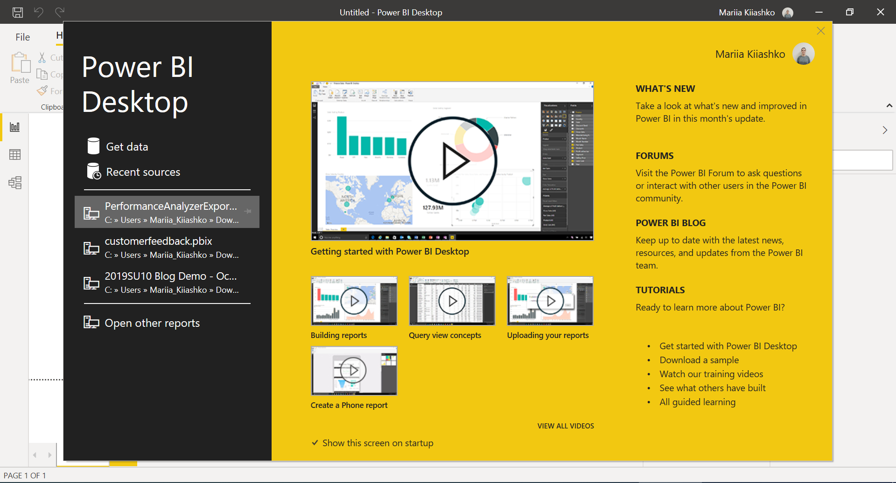
Introduction to Power BI platform
Power bi desktop
Power BI Desktop is a free development, authoring, and publishing tool of Power BI.
It is a user interaction platform from where users can connect to multiple data sources, transform and clean data, visualize and create reports.
Power BI Desktop is a user-friendly development platform leveraging on all the capabilities of Power BI.
Download Power BI Desktop
Download Power BI Desktop for Report Server

Slide 5
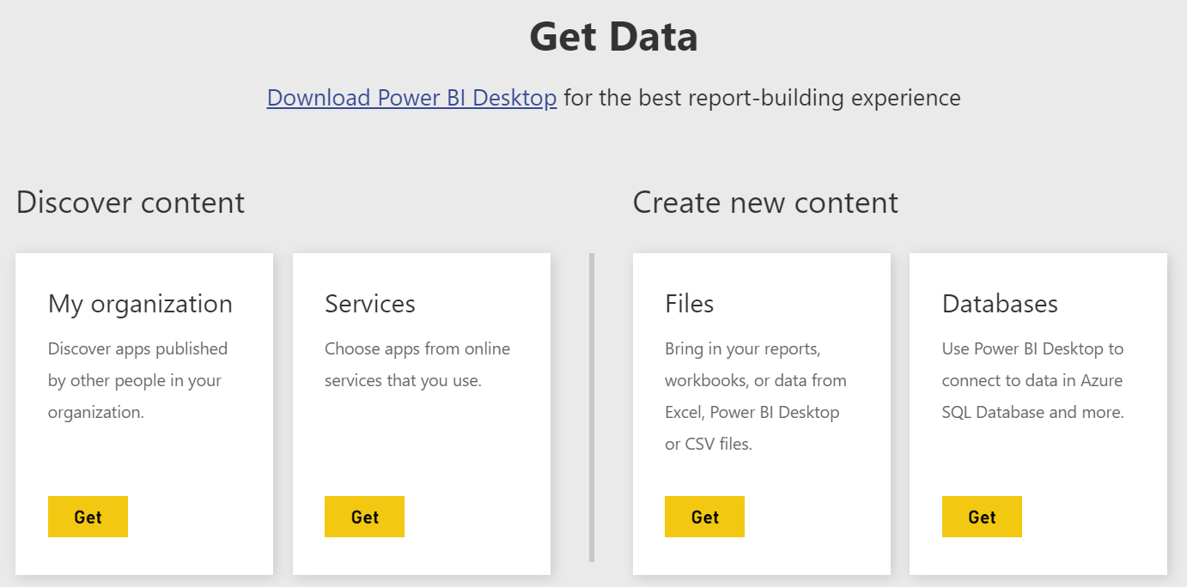
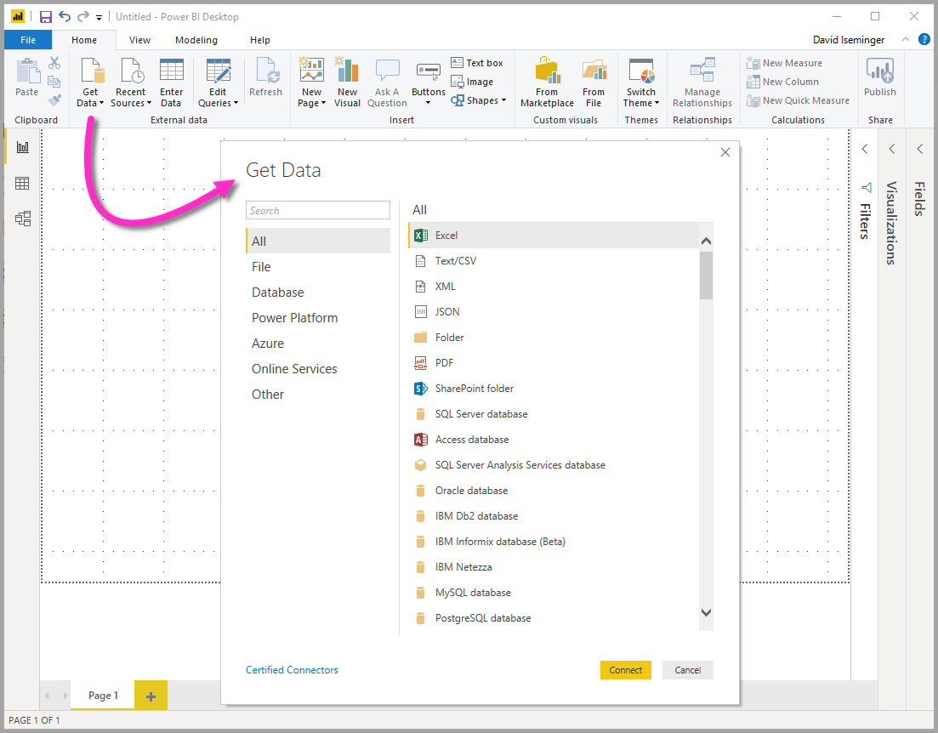
Introduction to Power BI platform
Power bi service Data sources
Power bi desktop data sources
Full list of Power BI Data Sources

Slide 6
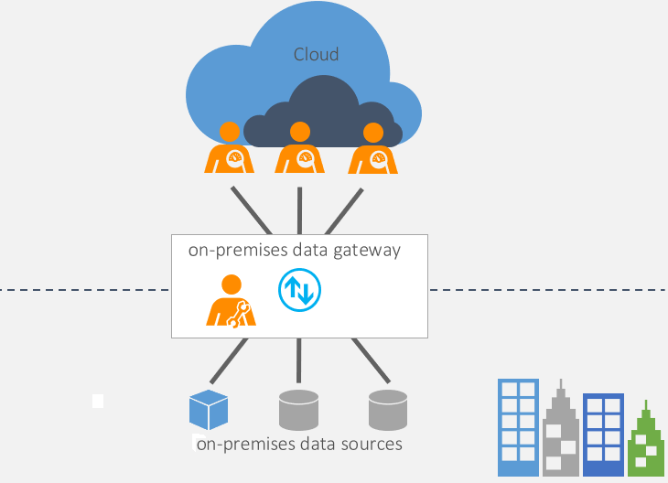
Introduction to Power BI platform
Power bi data Gateway
On-premises data gateway allows multiple users to connect to multiple on-premises data sources. You can use an on-premises data gateway with all supported services, with a single gateway installation. This gateway is well-suited to complex scenarios with multiple people accessing multiple data sources. Can be used with Power BI, Power App, Power Automate (Flow), Azure Logic Apps.
On-premises data gateway (personal mode) allows one user to connect to sources, and can’t be shared with others. An on-premises data gateway (personal mode) can be used only with Power BI. This gateway is well-suited to scenarios where you’re the only person who creates reports, and you don't need to share any data sources with others.
Download Power BI Gateway:
https://powerbi.microsoft.com/en-us/gateway/

Slide 7
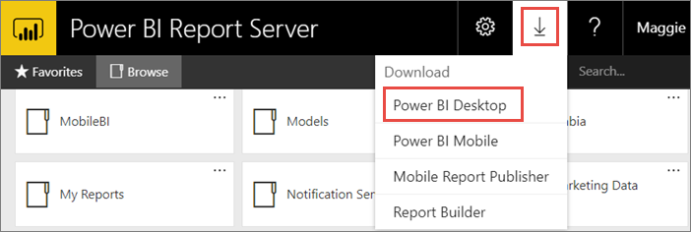
Introduction to Power BI platform
Power bi report server
The Power BI Report Server is similar to the Power BI Service. The main difference between these two is that Power BI Report Server is an on-premise platform. It is used by organizations who do not want to publish their reports on the cloud and are concerned about the security of their data.

Slide 8
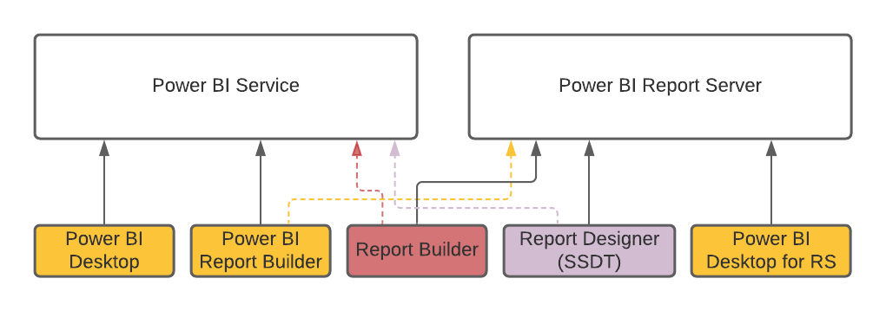
Introduction to Power BI platform
Report builder & power bi report builder & report designer (ssdt) &
Power BI Desktop for Report Server
Report Builder, Power BI Report Builder and Report Designer in SQL Server Data Tools (SSDT) are tools for authoring paginated reports that you can publish to the Power BI service or Power BI Report Server.
When you design a paginated report, you're creating a report definition that specifies what data to retrieve, where to get it, and how to display it.
When you run the report, the report processor takes the report definition you have specified, retrieves the data, and combines it with the report layout to generate the report.
You preview your report in Report Builder, Power BI Report Builder or Report Designer. Then publish your report to the Power BI service or Power BI Report Server.
Download Power BI Report Builder
Download Report Builder
Get Report Designer
Download Power BI Desktop for Report Server

Slide 9
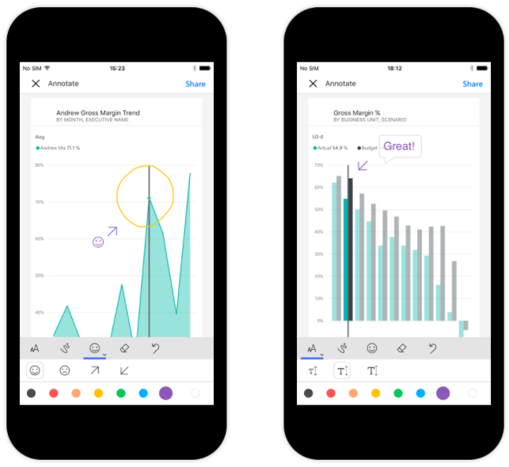
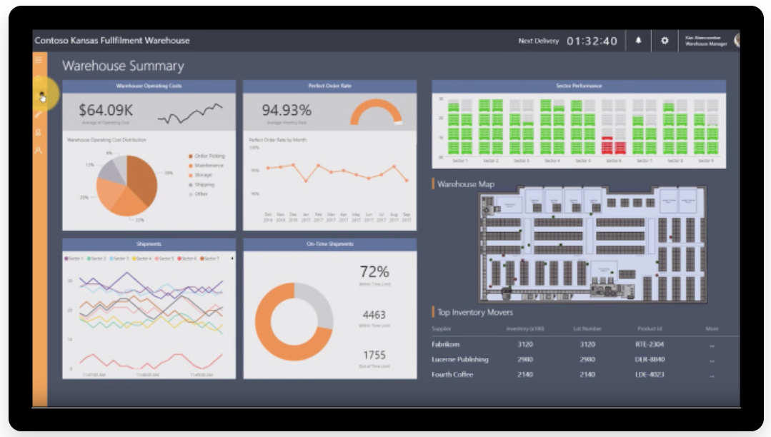
Introduction to Power BI platform
Power bi mobile
Power bi embedded
Power BI Mobile is a native Power BI application that runs on iOS, Android, and Windows mobile devices.
Power BI Desktop allows developers to set up a report layout for mobile devices.
The Power BI service (SaaS) and the Power BI Embedded service in Azure (PaaS) have APIs for embedding your dashboards and reports. When embedding content, this gives you access to the latest Power BI features such as dashboards, gateways, and workspaces.

Slide 10
Power BI Service objects

Slide 11
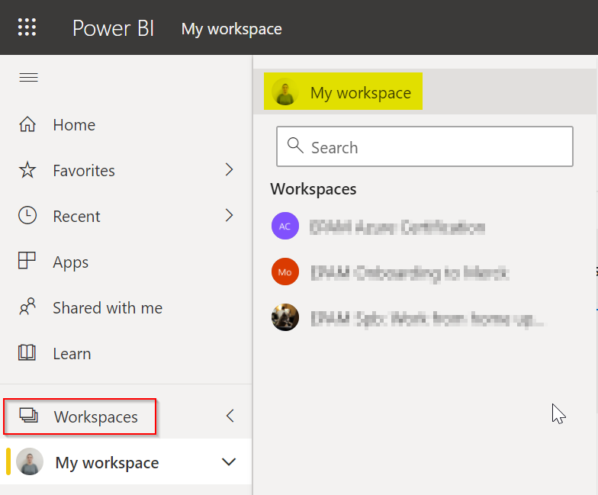
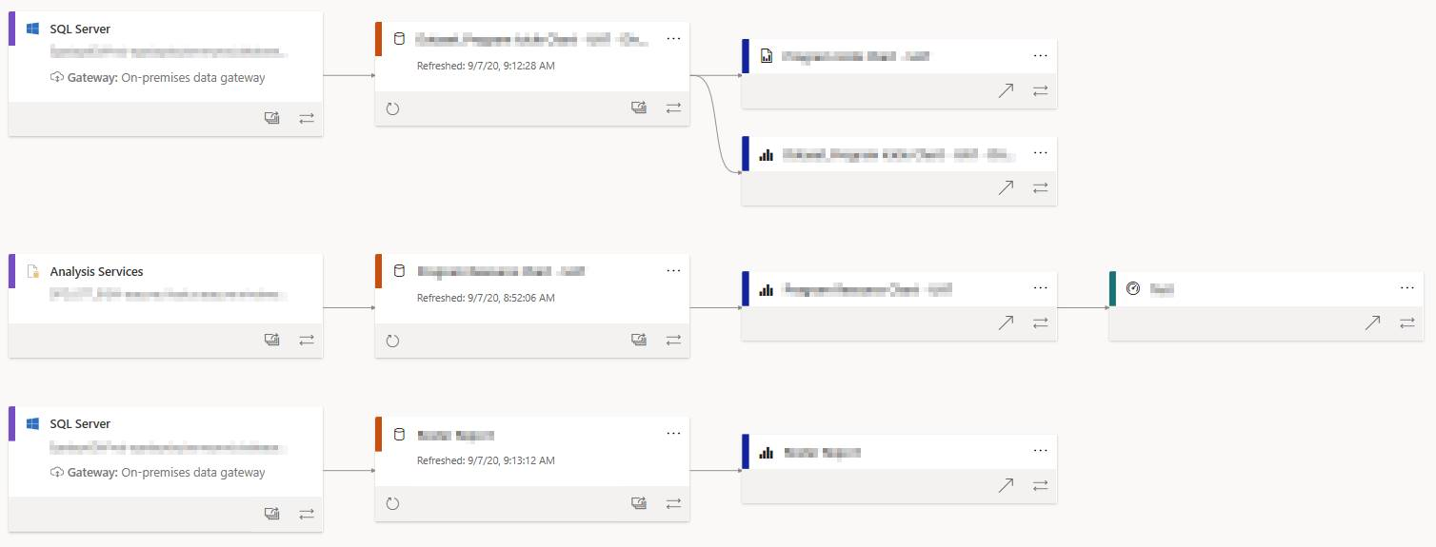
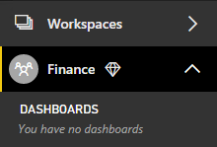
Power BI Service objects
workspace
Each users has “My workspace” and optionally several workspaces for collaboration
Power BI Workspace has very useful option – View Type. Workspace objects can be displayed as a list and as a lineage, so users can see all the dependencies.

Slide 12
Power BI Service objects
Content
Standard Report
Report created in Power BI Desktop (.pbix)
Contains dataset which becomes visible after publishing to Power BI Service
Paginated report
Report created in Power BI Report Builder or in another paginated report building tool (.rdl)
Doesn’t contain dataset, only report is visible after publishing to Power BI Service
Workbook
Excel file (.xlsx) as a workbook which can be viewed using Excel Online built into Power BI Service
Dashboard
Generated automatically after Power BI standard report first publication
Can be created manually using Power BI Service

Slide 13
Power BI Service objects
Datasets and dataflows
Power BI datasets represent a source of data ready for reporting and visualization. There are five different dataset types, created in the following ways:
Connecting to an existing data model that isn't hosted in a Power BI capacity
Uploading a Power BI Desktop file that contains a model
Uploading an Excel workbook (containing one or more Excel tables and/or a workbook data model), or uploading a CSV (comma-separated values) file
Using the Power BI service to create a push dataset
Using the Power BI service to create a streaming or hybrid streaming dataset
A dataflow is a collection of entities (entities are similar to tables) that are created and managed in workspaces in the Power BI service. You can add and edit entities in your dataflow, as well as manage data refresh schedules, directly from the workspace in which your dataflow was created.
Once you create a dataflow, you can use Power BI Desktop and the Power BI service to create datasets, reports, dashboards, and apps that are based on the data you put into Power BI dataflows, and thereby gain insights into your business activities.

Slide 14
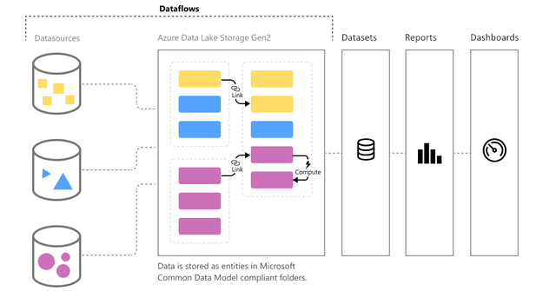
Power BI Service objects
Datasets and dataflows

Slide 15
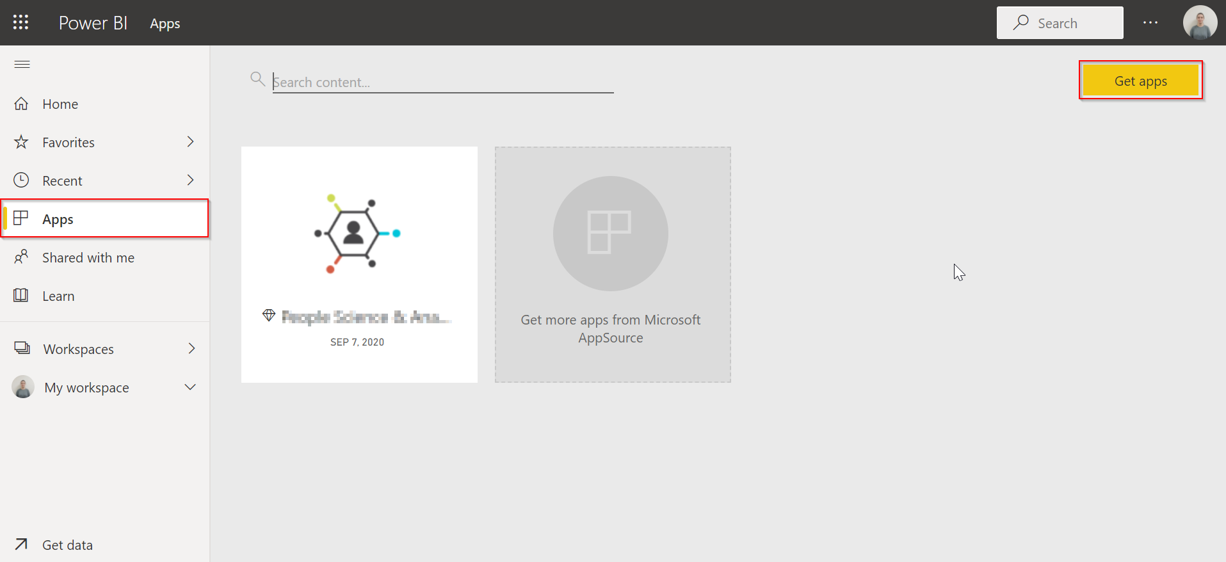
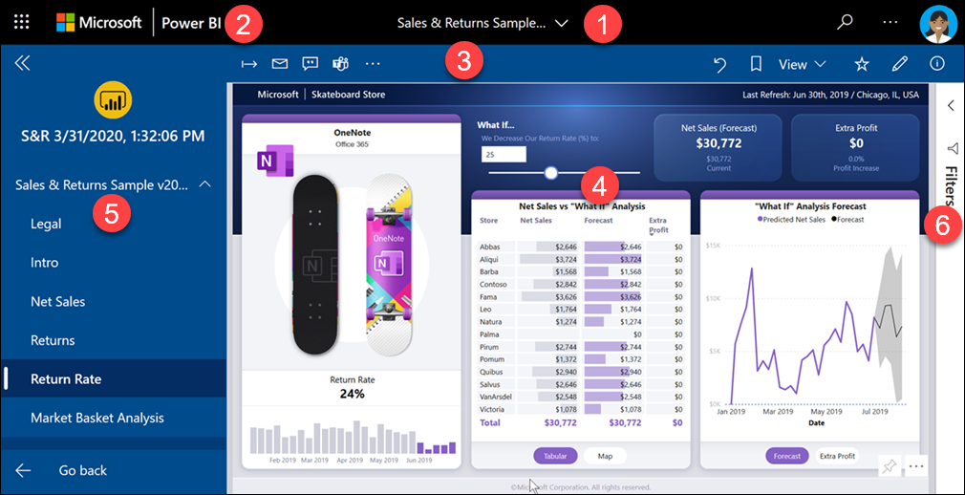
Power BI Service objects
Power bi App
An app is a Power BI content type that combines related dashboards and reports, all in one place.
An app can have one or more dashboards and one or more reports, all bundled together.
Apps are created by Power BI designers who distribute and share the apps with their colleagues.

Slide 16
Useful resources

Slide 17
Useful Resources
Power BI Community (Q&A, blogs)
Power BI Galleries (webinars, videos, reports, dashboard, themes, etc.)
Power BI Documentation

